Slide 1
COVID-19 ON SOCIAL MEDIA: ANALYZING MISINFORMATION IN TWITTER CONVERSATIONS
~ Karishma Sharma, Sungyong Seo, Chuizheng Meng, Sirisha Rambhatla, Yan Liu
Presented by
21266014 Md. Rezuwan Hassan
21266017 Shafin Mahmud Jalal
21266037 Rufaida Tasin
21273001 Masum Uddin Ahmed
22173003 S. M. Niaz Morshed
Group: 04

Slide 2
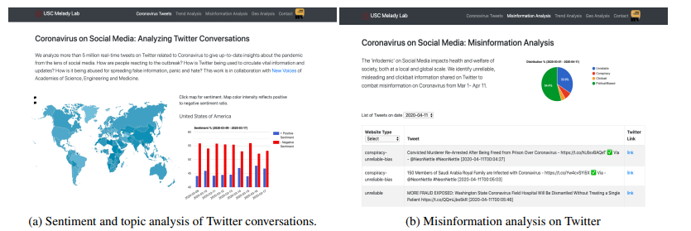
Introduction
Social medias are a major source of communication
Misinformation can easily be conveyed via social media.
Spreading misinformation takes toll on people’s mental health
A dashboard is created to analyze misinformation using twitter API
Presenter: Md. Rezuwan Hassan | ID: 21266014

Slide 3
Related Work
Lisa Singh, Shweta Bansal, Leticia Bode, Ceren Budak, Guangqing Chi, Kornraphop Kawintiranon, Colton Padden, Rebecca Vanarsdall, Emily Vraga, and Yanchen Wang. A first look at covid-19 information and misinformation sharing on twitter. arXiv preprint arXiv:2003.13907, 2020
Limeng Cui and Dongwon Lee. Coaid: Covid-19 healthcare misinformation dataset, 2020
Matteo Cinelli, Walter Quattrociocchi, Alessandro Galeazzi, Carlo Michele Valensise, Emanuele Brugnoli, Ana Lucia Schmidt, Paola Zola, Fabiana Zollo, and Antonio Scala. The covid-19 social media infodemic. arXiv preprint arXiv:2003.05004, 2020
Gordon Pennycook, Jonathon McPhetres, Yunhao Zhang, and David Rand. Fighting covid-19 misinformation on social media: Experimental evidence for a scalable accuracy nudge intervention
Presenter: Rufaida Tasin | ID: 21266037

Slide 4
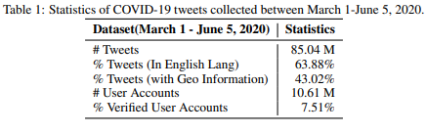
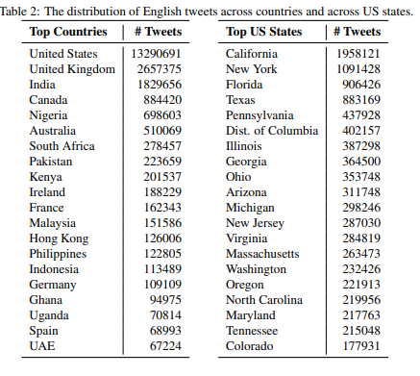
Data collection
Presenter: Rufaida Tasin | ID: 21266037

Slide 5
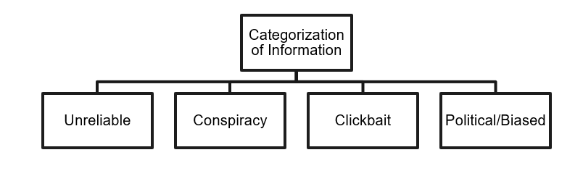
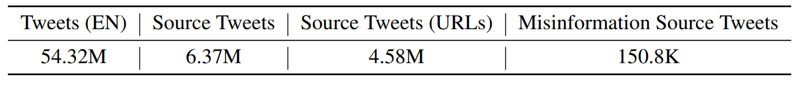
Misinformation
Domain specific dataset on COVID-19
Presenter: S. M. Niaz Morshed | ID: 22173003

Slide 6
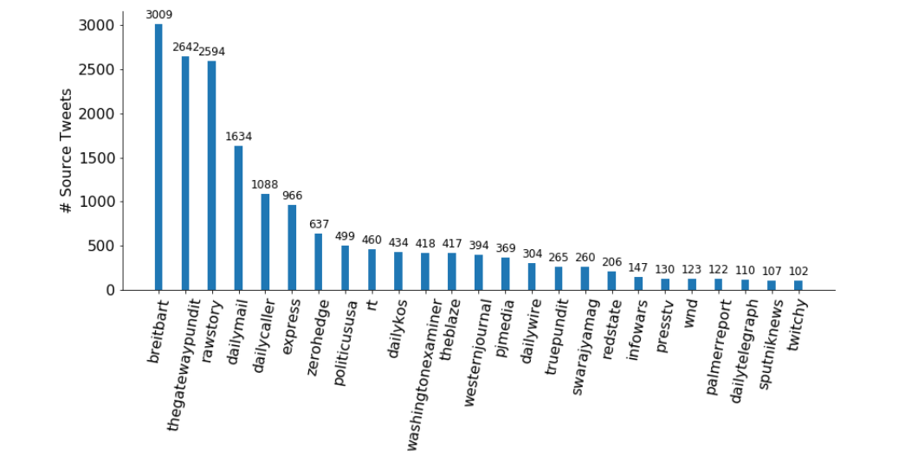
Misinformation Analysis
Presenter: S. M. Niaz Morshed | ID: 22173003

Slide 7
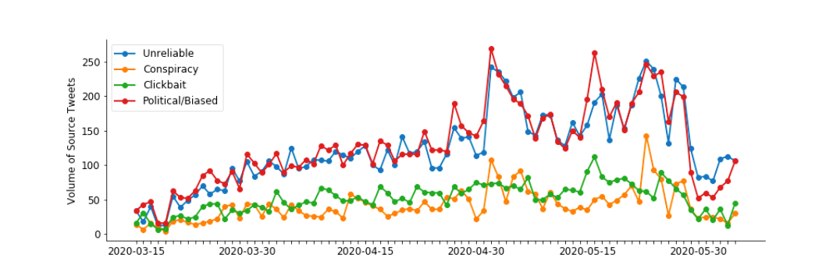
Misinformation Analysis
Presenter: S. M. Niaz Morshed | ID: 22173003

Slide 8
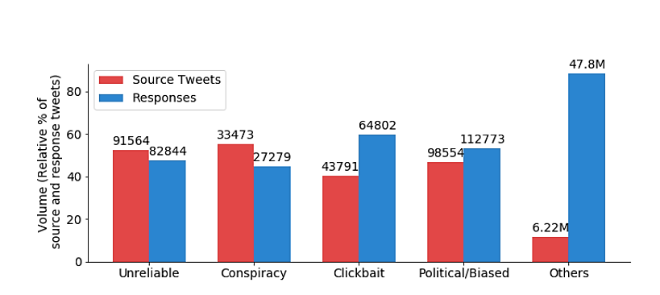
Misinformation Analysis
Presenter: S. M. Niaz Morshed | ID: 22173003

Slide 9
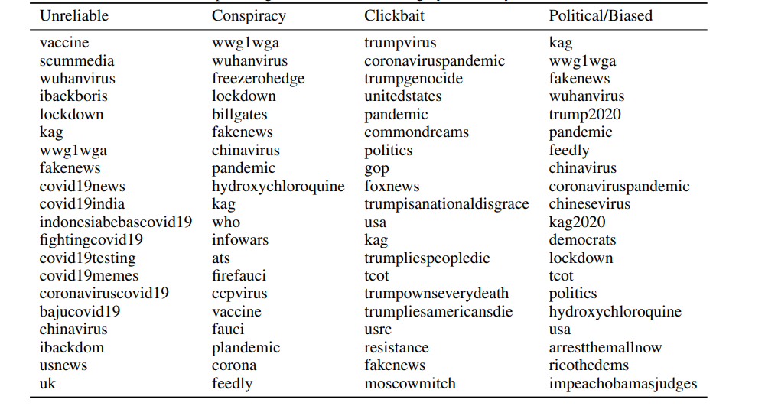
Misinformation Analysis
Presenter: S. M. Niaz Morshed | ID: 22173003

Slide 10
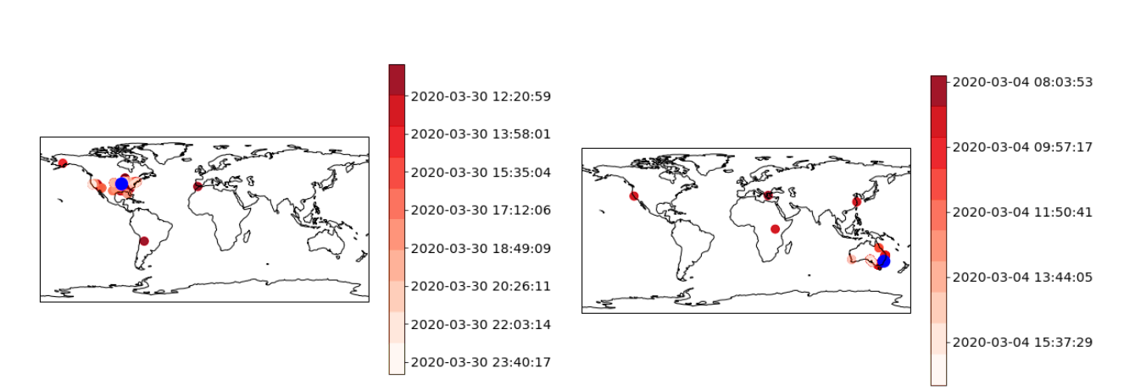
Misinformation Analysis
Presenter: S. M. Niaz Morshed | ID: 22173003

Slide 11
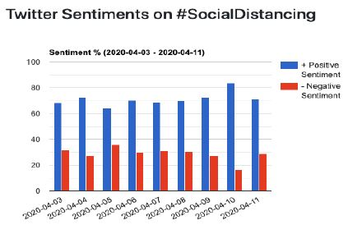
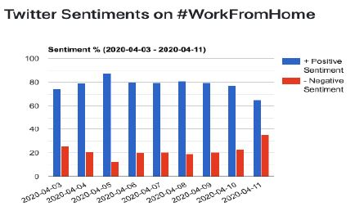
Sentiment Analysis
Country-wise sentiments
Social distancing/Work from home sentiments
Presenter: Shafin Mahmud Jalal | ID: 21266017

Slide 12
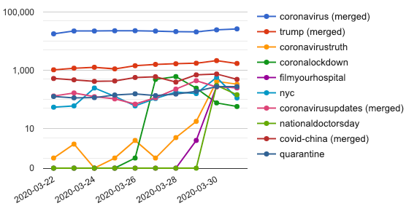
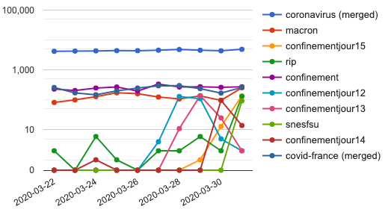
Topic and Trend Analysis
Identification of topics and trends based on Twitter data on COVID-19
Changes of the emerging trend on Twitter highlight
United States, March 22-31
France, March 22-31
Presenter: Masum Uddin Ahmed | ID: 21273001

Slide 13
Conclusion and Future Work
Analysis of social media discourse about COVID-19
Identification of misinformation using information about low-quality news websites
Proportion of Twitter users in the United state
Real-time tracking of misinformation
Prevention of dire consequences of misinformation
Presenter: Masum Uddin Ahmed | ID: 21273001

Slide 14


